Slide 1
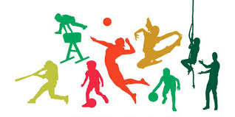
PHYSICAL FITNESS (SpSc 101)

Slide 2
UNIT ONE CONCEPTS OF PHYSICAL FITNESS
UNIT OBJECTIVES
By the end of this unit you should be able to:
Define physical fitness, physical activity, physical exercise and sport
Understand the benefits of physical fitness
Realize general principles of fitness training
Make behavior modification to stay fit

Slide 3
1. Meanings and Definitions of Terms 1.1 Physical fitness
the body’s ability to function effectively and efficiently, and contributes the total quality of life.
The United States president’s Council on physical fitness and sports defined the terms physical fitness as
the ability to carry out daily task with vigor and alertness, without undue fatigue, with ample energy to enjoy leisure time pursuits and to meet unforeseen emergencies” (Clarke, 1971).

Slide 4
Physical fitness is essential for human beings to adjust well with environment as mind and body are in complete harmony.
physical fitness is an important part of the normal growth and development of a child

Slide 5
the multi-dimensional characteristics of physical fitness can be divided into two areas: health related physical fitness and skill related physical fitness

Slide 6
Skill-Related Physical Fitness
Skill or performance related fitness is associated with performance than good health.
Those are the basis for successful sports participation.
Fitness in motor skills is essential in activities such as basketball, racquetball, golf, soccer, and water skiing.
The components of skill related physical fitness are agility, balance, coordination, power, speed, and reaction time.

Slide 7
1. Agility
It is the ability to change body position and direction quickly, efficiently with proper control bodily movement.
Agility is important in sports such as basketball, soccer, gymnastics, racquet games and so on.
E.g. a gymnast performing somersaults, and a rugby player running for the try line need agility to dodge a defender who is trying to tackle him.
It is a combination of: Balance, Speed, Strength, and Coordination.
Exercise to improve agility: zigzag running, Lateral Plyometric Jumps, Shuttle Runs, high-Knee Drill, Side-to-Side Drill, Forward-Backward Sprints, Stair Running and so on.

Slide 8
2. Balance
It is the ability to maintain the body at equilibrium while at rest or when on the move.
Both types of static and dynamic balance are needed in some sports, e.g. a gymnast could be holding a balance, on handstand, on the beam (static balance) or keeping balanced while on the move, e.g. a walk-over (dynamic balance).
Exercise to improve balance: Stand on One Foot, Heel-to-Toe Walk, Back Leg Raise, Side Leg Raise (speedy body weight shifts), Knee Curl, Toe Stand, Line dancing and so on.

Slide 9
3. Power
It is the ability to produce maximum force in the shortest time.
The two components of power are muscle force (strength) and speed.
An effective combination of these two components allows a person to produce explosive movements such as jumping, sprinters, putting the shot, spiking, throwing, and hitting the ball.
Examples of exercise to improve power: Plate Jump, Box Squat Jump, Dumbbell, Swing Threw Jump, Frog Squat Jump, Medicine Ball Throws, and so on.

Slide 10
4. Speed:
It is the ability to cover a distance in a short period of time.
It is also to propel the body or a part of the body rapidly from one point to another.
Examples of activities that require good speed for success are soccer, basketball, and sprinting in track.

Slide 11
Exercise to improve Starting ability (acceleration): Stride length and high knee kicks by Hip Joint Flexion (increase after initial acceleration), Stride rate by Heel Raise (number of steps per time), and Speed endurance

Slide 12
5. Coordination
It is the ability to integrate the nervous system and the muscular system to produce correct, graceful, and harmonious body movements.
This component is important in a wide variety of motor activities, such as golf, baseball, karate, soccer, and racquetball, in which hand eye or foot-eye movements, or both, must be integrated.

Slide 13
Exercise to improve coordination:
Multi-directional forms of running, jumping and skipping
Single leg balancing games
Mirror games (mirroring each other’s movements)

Slide 14
Known exercises starting or finishing in new positions (start sprints from belly or one knee; end with hands up)
Opposite arm circles (right hand circles forward, left backwards)
Arm and leg circles
Rope jumping (crisscross)
Somersault to balance (somersault to standing one legged balance)
Obstacle running (place hurdles directly on floor and have athlete run over them)

Slide 15
6. Reaction time
It is the time elapsed between stimulation and beginning of reaction (response) to that stimulation.
Good reaction time is important for starts in track and swimming; playing tennis at the net, boxing, and karate.
E.g. The time between the trigger being pulled, the gun firing and the athletes starting to sprint.

Slide 16
Anticipation from experience can help reaction time improvement.
Improve reaction time: Be aware, Anticipation and kinesthetic sense, Rehearse the specific response that you want to react to quicker repeatedly, Practice dropping a ball with partner, Ball throw with shifting a place, and so on.

Slide 17
Health –related
Health can be defined as a state of complete physical, mental and social well-being, not merely the absence of disease.
Health is optimal well-being that contributes to quality of life.
It is more than freedom from disease and illness.

Slide 18
Health has three dimensions: mental, physical, and social well-being.
The three dimensions of health are tightly interdependent, and quality of life demands that each receives balanced attention.
Muscular endurance: is the ability of muscles to perform or sustain muscle contraction repeatedly over a period of time.

Slide 19
Contin………
It enables muscles to be exercised repeatedly without getting unduly tired in a long period of time.
For example in activities such muscle fatigue resistance in running, dumbbell lifting, and swimming.

Slide 20
Flexibility
It is the range of motion at a joint, a serious of joints and its surrounding muscles.
The main benefits of flexibility of joint range of motion are performance enhancement and reduced injury risks.

Slide 21
Muscular strength
It is the ability of muscle and muscle groups to exert force against a resistance.
is the ability or capacity of a muscle or muscle groups to exert force against resistance. It also refers to a muscles ability to exert maximal force in a single effort

Slide 22
Muscular strength enables the lifting of very heavy weights. It is important if work or a particular sport involves the exertion of great force.
Muscular strength can be developed by lifting heavy weights with few repetitions or by high-intensity strength work.

Slide 23
Body composition:
It is the percentage amount of lean body mass (muscle and bone) and adipose tissue (fat mass) in the human body.
It is the percentage of fat in the body relative to the percentage of all other tissue including bones, muscle, tendon, ligaments, skin and etc…

Slide 24
Body Composition
The most common techniques interpreted in this level are skin fold thickness, body mass index, waist circumference, and hydrostatic (underwater) weighing.
Hydrostatic, or underwater weighing is advanced and commonly used in exercise physiology and fitness laboratories.

Slide 25
Disease Risk According to Body Mass Index (BMI)
BMI | Disease Risk | Category
≤ 18.5 | Increased | Underweight
18.5–21.99 | Low | Acceptable
22.0–24.99 | Very low | Acceptable
25.0–29.99 | Increased | Overweight
30.0–34.99 | High | Obesity I
35.0–39.99 | Very high | Obesity II
≥ 40.0 | Extremely high | Obesity III

Slide 26
Cardiovascular endurance: the ability of the heart, blood vessels, and respiratory system to supply fuel and oxygen to the muscle and the muscle utilizes fuel to allow sustained exercise.
Cardio respiratory fitness: describes the efficiency of the heart, lungs, blood and blood vessels to deliver oxygen to the working muscles that a prolonged physical work can be maintained.

Slide 27
Physical Activity
Physical Activity:- It is bodily movement produced by skeletal muscles that results in energy expenditure.
Physical activity is defined as any skeletal muscle contraction that results in an increased energy expenditure.
Based on predominant physiologic effect, physical activity can be categorized in to aerobic physical activity and anaerobic physical activity.

Slide 28
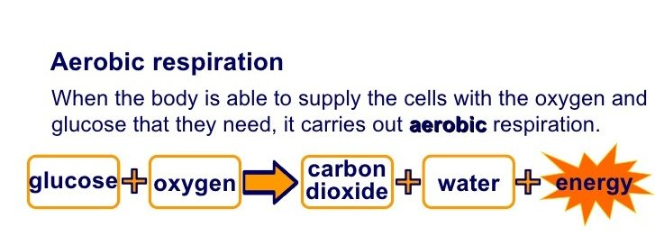
Respiration is a continuous process in every living organism and without respiration no organism can survive on the earth. The respiration is defined as yeah process of “oxidation of food materials especially glucose, fatty acids and amino acids to water and carbon dioxide”.
there are mainly two types of respiration called aerobic respiration and anaerobic respiration. The main aim of this article is to communicate the differences between aerobic respiration and anaerobic respiration.
AEROBIC RESPIRATION
Aerobic Respiration is the type of respiration which takes place in the presence of oxygen. The aerobic respiration is generally common in all multi cellular organisms like animals, plants, human beings, etc.

Slide 29
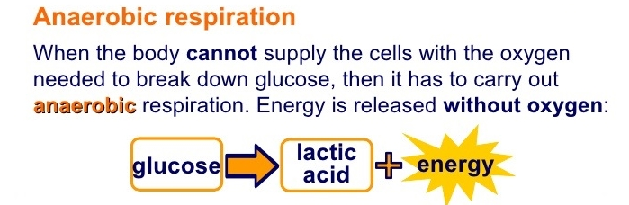
ANAEROBIC RESPIRATION
Anaerobic Respiration is the type of respiration which is carried out by yeast or muscle cells in the absence of oxygen. The anaerobic respiration is common in unicellular organisms like protozoa, fungi, bacteria, etc.

Slide 30
Aerobic physical activity
Aerobic physical activity includes forms of activity that are intense enough and performed long enough to maintain or improve an individual’s cardiorespiratory fitness.
Aerobic activities such as walking, basketball, soccer, or dancing, commonly require the use of large muscle groups.

Slide 31
The connection between aerobic activities such as these and cardiorespiratory fitness is sufficiently close that the term “aerobic capacity” is considered equivalent to cardiorespiratory fitness.
Technically, aerobic physical activity includes any activity that could be maintained using only oxygen-supported metabolic energy pathways and could be continued for more than a few minutes.

Slide 32
anaerobic physical activity
anaerobic physical activity refers to high-intensity activity that exceeds the capacity of the cardiovascular system to provide oxygen to muscle cells for the usual oxygen consuming metabolic pathways.
Anaerobic activity can be maintained for only about 2 to 3 minutes. Sprinting and power lifting are examples of anaerobic physical activity.

Slide 33
Physical Exercise
Exercise is defined as Planned, structured, repetitive, and purposeful physical activity aimed at improving or maintaining of one or more components of physical fitness is an objective or health.
. e.g. training for or performing athletics, sports, or recreational activities such as jogging, swimming, etc.
The formula relating physical activity and exercise is:
kcalExerclse + kcalNonexercise` = kcalTotal daily Physical activity

Slide 34
Generally, Exercise describes as planned structured and repetitive bodily movement done to improve or maintain one or more components of physical fitness and is subset of physical activity.
Exercise is usually goal related and designed in the sense that the improvement or maintenance of one or more components of physical fitness (i.e., endurance, strength, flexibility etc…).

Slide 35
Good Habits for Good Health
Regular physical activity
Eating well
Managing stress
Avoiding destructive habits
Adopting good safety habits

Slide 36
Learning first aid
Adopting good personal health habits
Seeking and complying with medical advice
Being an informed consumer
Protecting the environment

Slide 37
Benefits of physical activity
Improves CVS fitness
Improves strength and muscular endurance
Improved wellness
Prevent from Hypokinetic or conditions. Because:-Too little movement and Inactivity may results metabolic diseases
Enhanced mental health and function

Slide 38
Opportunity for successful experience and social interaction
Improved Appearance
Bone development
Reduced cancer risk
Reduced effects of acquired Aging

Slide 39
Sport it is an organized, competitive form of play.
is physical activity or movement involving rules and competition. Football, hockey, basketball and badminton are examples of specific sporting activities.
Game competitive form of play.
Play can at times be sport, but strictly speaking, sport is never simple play; the competitive aspect is essential to the nature of sport.
Exercise science is the study of how physical activity or exercise affects human health and function.
Sports science is the study of how physical activity or function affects sports performance.

Slide 40
1.2 General Principles of Fitness Training
Training is a systematic process in which athletes can improve their fitness to meet the demands of their sport/activity.
Training is a long-term process that is progressive and meets the individual at their level of fitness and condition.
Training can uses both general and event-specific exercises to develop individuals for their sport.

Slide 41
There are 8-10 Principles of training in the development of Physical Fitness:
Specificity
Individual Differences (Individuality)
Overload
Progression
Principle of Rest, Recovery, and Per iodization
Tedium
Reversibility
Warming up and Cooling down

Slide 42
Principles of Training
The principle of overload
“Exercising at a higher level than normal.
The principle of progression:
“Gradually increasing the level and intensity of exercise.”
The principle of consistency
Engaging in fitness activities on a regular basis.”

Slide 43
Cont…
The principle of specificity:
“The type of physical changes that occur directly related to the type of training used.”
The principle of individuality
No two individuals are exactly the same.”
The principle of reversibility
“The benefits achieved from overload last only as long as overload continues.”

Slide 44

Principles of training
When planning any training, you have to apply the principles of training.
The principles can be easily memorized using the mnemonic, SPORT.
Specificity
Progression
Overload
Reversibility
Tedium
S
P
O
R
T

Slide 45
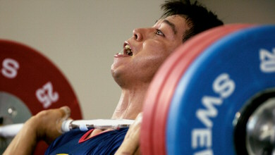
Specificity
You must do specific types of activity to improve specific parts of the body in specific ways.
Different events can require very different forms of training.
For example, if you’re training for a weightlifting competition, it’s no use going swimming every day.
You need to concentrate on strength training for your arms and legs.

Slide 46
Specificity
You need to train specifically to develop the right…
muscles – if your sport requires a lot of running, work mainly on your legs.
type of fitness – do you need strength, speed, stamina or a combination?
skills – you need to practice any relevant skills like kicking, serving and passing.
Remember that:
specific individuals respond differently to the same exercise. Training may need to be adapted to suit the needs of different participants.

Slide 47
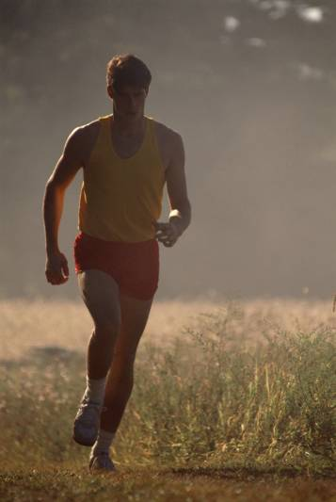
Progression
Progression means gradually increasing the amount of exercise you do.
When a performer first starts exercising, their levels of fitness may be poor.
If a coach increases the training too quickly, the body will not have time to adapt and this may result in injury. Slow and steady progress is the best way forward.
For example, if you were training for a 10 km run, you might start by going for two 30 minute runs a week.
You could then increase the time you run for by 3 minutes each week.
Notes:
Image © 2006 Jupiterimages Corporation

Slide 48
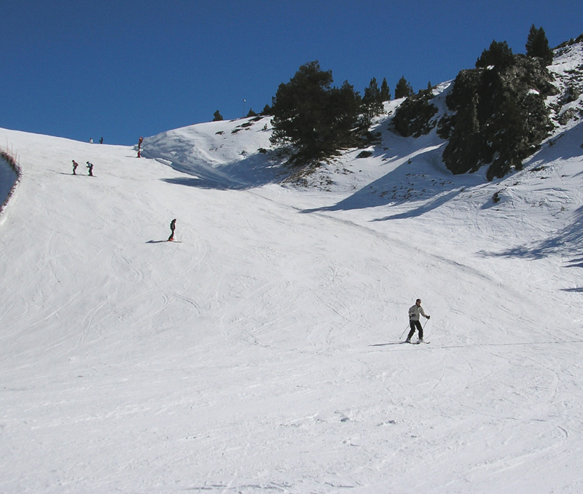
Progression
Gradually increasing the frequency, intensity and duration of fitness sessions is an important factor in developing an effective training programme.
In terms of type of training, progression should be based on the principle of moving from easy activities to difficult ones.
For example, if you were creating a training programme for a novice skier, you would not start them off on a really steep, difficult run.

Slide 49
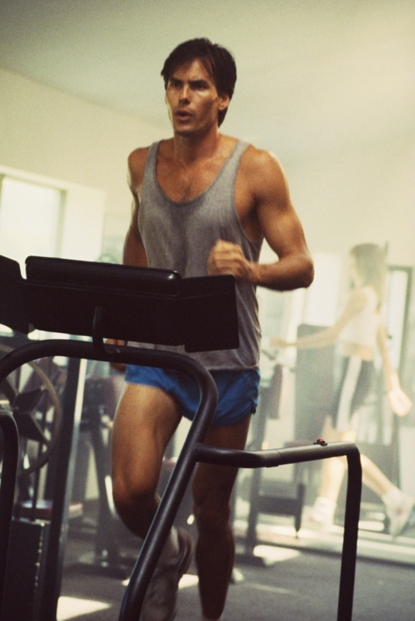
Overload
Fitness can only be improved by training more than you normally do.
Unless the body is subjected to increased demands, improvements in physical fitness will not be made.
If a physical fitness programme is to be effective, it must place increased and specific demands on the body. If training levels remain the same, then the programme will only be maintaining the participants level of fitness, not improving it.
Remember though – you can train too much!
Notes:
Image © 2006 Jupiterimages Corporation

Slide 50
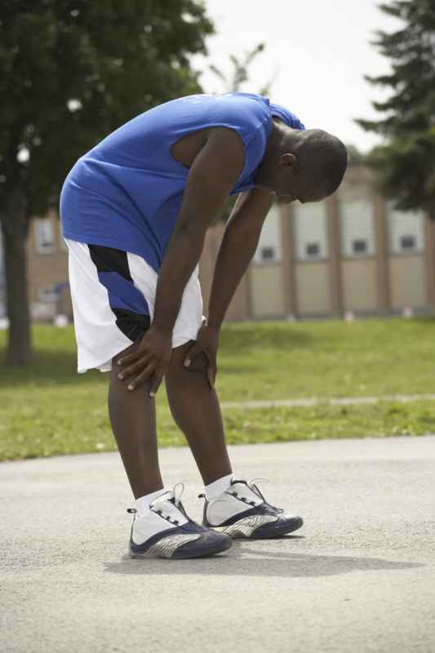
Overload: the FITT principle
There are four ways to achieve overload in an exercise programme. They can easily be remembered using the mnemonic, FITT.
Frequency – how often you train.
Intensity – how hard you train.
Time (or duration) – how long you train for.
Type – the kind of training you do.
Notes:
Image © 2006 Jupiterimages Corporation

Slide 51
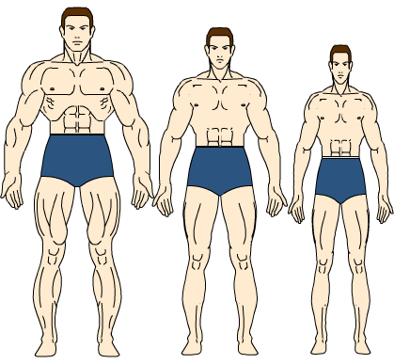
Reversibility
Unfortunately, most of the adaptations which result from training are reversible.
This simply means that unless you keep training, any fitness gains will be lost.
Fitness will be lost if the training load is reduced (meaning overload is not achieved) or if a performer stops training, for example, if they are injured.
Coaches need to ensure that long periods of inactivity are avoided when possible.
Endurance can be lost in a third of the time it took to achieve! Strength declines more slowly, but lack of exercise will still cause muscles to wither (atrophy).

Slide 52
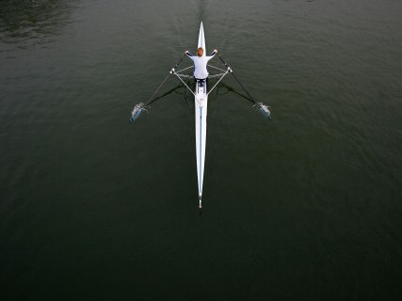
Tedium
When planning a training programme, it is important to vary the training a bit to prevent performers becoming bored.
If every training session is the same, a performer can lose enthusiasm and motivation for training.
You should include a variety of different training methods or vary the type of activity.
Training for endurance events can be particularly boring. Tedium is less of a problem in team sports.
Why can it sometimes be difficult to avoid tedium while obeying the first principle – specificity?

Slide 53
Principles of Individuality (individual differences)
Everyone is different and responds differently to training. Some people are able to handle higher volumes of training while others may respond better to higher intensities.

Slide 54
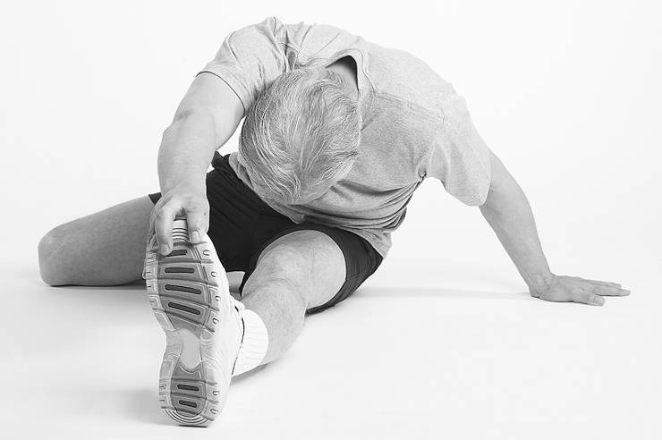
Individual needs
All training programmes must consider the individual needs of the performer.
Before designing a training programme, you need to ask the following questions about the individual:
What is their initial level of fitness?
How old are they?
Are they male or female?
Why do they want to train?
What is their aim or motivation?
The answers will help you to tailor the training programme to the individual needs and abilities of the performer.
Notes:
Image © 2006 Jupiterimages Corporation

Slide 55
The Warm-Up
When commencing a bout of exercise, the body needs to make a number of adjustments.
The purpose of a warm-up is to encourage these adjustments to occur gradually, by commencing your exercise session at an easy level and increasing the intensity gradually.

Slide 56
If you were to start exercising at a strenuous level without a warm-up, your body would be ill-prepared for the higher demands being made of it, which may cause injury and unnecessary fatigue.
Need of warm-up
A warm-up usually takes the form of some gentle exercise that gradually increases the intensity.
Increasing your breathing and heart rate for the next activity;

Slide 57
Increases blood flow to the muscles, which enhances the delivery of oxygen, & nutrients;
Increase body temperature.
Prepares your muscles for stretching;
Prepares you mentally for the upcoming exercise;
Primes your nerve-to-muscle pathways to be ready for exercise;

Slide 58
Warms your muscles, which promotes the energy-releasing reactions used during exercise and makes the muscles more supple;
Prevents unnecessary stress and fatigue being placed on your muscles, heart, and lungs, which can occur if you exercise strenuously without a warm-up.

Slide 59
The Cool-Down
The practice of cooling down after exercise means slowing down your level of activity gradually.
- Helps your heart rate and breathing to return towards resting levels gradually;
Helps avoid fainting or dizziness, which can result from blood pooling in the large muscles of the legs when vigorous activity is stopped suddenly;

Slide 60
Helps to remove waste products from your muscles, such as lactic acid, which can build up during vigorous activity.
Helps prepare your muscles for the next exercise session.

Slide 61
Principle of Rest, Recovery, and Periodization
The principle of rest and recovery (or principle of recuperation) suggests that rest and recovery from the stress of exercise must take place in proportionate amounts to avoid too much stress.
optimal rest and recovery can be achieved without overstressing the athlete. This training principle, called periodization, is especially important to serious athletes but can be applied to most exercise plans as well.

Slide 62
Planning
Planning is a process of setting objectives and deciding how to accomplish them. Coaching without planning is wasting time or worse.
Inappropriate/ poor plan may cause:
injury,
long term damage,
may force the athlete to quit the sport.

Slide 63
Periodization
It is a process of dividing the annual plan into smaller phases of training in order to allow a program to be set into more manageable segments and to ensure a correct peaking for the main regatta of the year
a logical aphasic method of varying training volume, intensity factors and exercises in order to optimize progress.

Slide 64
cont…
The primary goal of per iodization are the avoidance of overtraining & performing at peak or optimal level at the right time
Without periodization, the stress from exercise would continue indefinitely eventually leading to fatigue, possible injury, and even a condition known as overtraining syndrome.
Overtraining syndrome is not well understood.

Slide 65
cont……
Training is a systematic process with the objective of improving an athlete’s fitness in a selected activity.
It is a long term process that is progressive and recognizes the individual athlete’s needs and capabilities.
Training program use exercise or practice to develop the qualities required for an athlete’s long term development.

Slide 66
symptoms of over training
Instead, weeks, months, and sometimes even years are required to overcome the symptoms of overtraining syndrome. Some of this Symptoms are:
weight loss
loss of motivation
inability to concentrate or focus
feelings of depression
lack of enjoyment in activities normally considered enjoyable
sleep disturbances
change in appetite

Slide 67
Phases of periodization
The principle of periodization suggests that training plans incorporate phases of stress followed by phases of rest.
Training phases can be organized on a daily, weekly, monthly, and even multi-annual cycles, called micro-, meso-, and macrocycles, respectively.

Slide 68
Training cycle
Macrocycle
Mesocycle
Microcycle
Group of mesocycle
Group of microcycles
Group of training session
"Training week“
Usually 3 months months and above.
usually one month but can vary from 3 to 7 wks
Usually 1wk but can vary 4-10 days

Slide 69
Phases of a yearly plan
yearly plan is generally divided into three main phases of training:
1. Preparation Phase (Pre-Season)
2. Competition Phase (In-Season) and
3. Transition Phase (Off-Season).

Slide 70
UNIT SUMMARY
Physical activity: any activity that requires skeletal muscle and requires energy aimed at improving health.
Exercise: a subset of physical activity that Is planned and structured aimed at improving fitness.
Health related components of fitness: types of activities dedicated to improving physical fitness categorized as cardiorespiratory endurance, muscular strength and endurance, flexibility, and body composition.

Slide 71
Skills related components of fitness: types of activities dedicated to improving physical skills categorized as speed, agility, coordination, balance, power, and reaction time.
Principles of adaptations to stress: guidelines related to managing the application of stress during physical activity/exercise.
Overload Principle: a principle of adaptation to stress suggesting the amount of stress applied during exercise must exceed a threshold level to stimulate adaptation.

Slide 72
Volume: the term used to describe “how much” stress is being applied by combining the duration and frequency of exercise.
Progression principle: a principle relating to how much additional stress that can safely be introduced to gradually improve fitness without risking injury or overuse.
Specificity: the principle of stress suggesting activities should be closely centered around the primary outcome goal, i.e. train the way you want to adapt.
Reversibility: the principle that adaptations to stress can be lost over time if training is modified or stopped.

Slide 73
Principle of rest and recovery: the concept that adaptation not only requires overload but also requires rest to avoid over stressing the body.
Periodization: a method of organizing workouts into blocks or periods. These cycles consist of work/stress periods and rest periods.
Over training syndrome: a condition of chronic stress from physical activity affecting the physical and psychological states of an individual or athlete.
Detraining: the act of no longer training at all or decreasing the amount of training.

Slide 74
UNIT TWO THE HEALTH BENEFITS OF PHYSICAL ACTIVITY
UNIT OBJECTIVES
By the end of this unit students should be able to:
Describe the health benefits of physical activity
Identify diseases which are associated with a sedentary lifestyle and the major risk factors for these diseases
Realize regular physical activity in terms of disease prevention and healthy aging?
Estimate physical activity needed for improved health benefits?
Identify physical activities suitable for typical people, and how often should they exercise?

Slide 75
The term “hypokinetic” was coined by Kraus and Raab in their book Hypokinetic Disease (Kraus &Raab, 1961).
The term “hypokinetic” can be used to describe many of the diseases and conditions associated with inactivity and poor fitness such as those conditions outlined in Physical Activity or low levels of habitual activity and Health
associated with inactivity and poor fitness such as those conditions outlined in Physical Activity and Health.
Physical inactivity has led to a rise in chronic diseases.
Each year at least 1.9 million people die as a result of physical inactivity.

Slide 76
Data from the Aerobics Center Longitudinal Study (2009) indicated that low cardiorespiratory fitness accounts for substantially more deaths (16%) compared to other risk factors (i.e., obesity 2–3%; smoking 8–10%; high cholesterol 2–4%; diabetes 2–4%; and hypertension 8–16%).
Individuals who do not exercise regularly are at a greater risk for developing chronic diseases such as coronary heart disease (CHD), hypertension, hypercholesterolemia, cancer, obesity, and musculoskeletal disorders

Slide 77
Role of physical activity and exercise in disease prevention and rehabilitation

Slide 78
that regular physical activity is the best defense against the development of many diseases, disorders, and illnesses.
In 1995, Center for Disease Control (CDC) and the American College of Sports Medicine (ACSM) recommended that every adult should accumulate 30 min or more of moderate-intensity physical activity on most, preferably all, days of the week.
recommended amounts of physical activity are in addition to routine activities of daily living (ADLs) such as cooking, shopping, and walking around the home or from the parking lot.
The intensity of exercise is expressed in metabolic equivalents (METs).
A MET is the ratio of the person’s working (exercising) metabolic rate to the resting metabolic rate.
One MET is defined as the energy cost of sitting quietly.

Slide 79
Summary of the ACSM and AHA physical activity recommendations for adults
*Combinations of moderate and vigorous-intensity may be performed to meet recommendation (e.g., jogging 20 min on 2 days and brisk walking on 2 other days). *Multiple bouts of moderate intensity activity, each lasting at least 10 min, can be accumulated to meet the minimum duration of 30 min.

Slide 80
Moderate-intensity aerobic activity (3.0–6.0 METs or 5 or 6 on a 10-point perceived exertion scale) is operationally defined as activity that noticeably increases heart rate and lasts more than 10 min (e.g., brisk walking for 15 min).
Vigorous-intensity activity (>6.0 METs or 7 or 8 on a 10-point perceived exertion scale) causes rapid breathing and increases heart rate substantially (e.g., jogging).
For adults (18–65 yr) and older adults (>65 yr), the ACSM recommends a minimum of 30 min of moderate-intensity aerobic activity 5 days per week or 20 min of vigorous-intensity aerobic exercise 3 days per week.

Slide 81
They also recommend moderate- to high-intensity (8- to 12-repetition maximum (RM) for adults and 10- to 15-RM for older adults) resistance training for a minimum of 2 nonconsecutive days per week.
Balance and flexibility exercises are also suggested for older adults.
For substantial health benefits, adults should engage in aerobic exercise at least 150 min per week at a moderate intensity or 75 min per week at a vigorous intensity.

Slide 82
In addition, adults and older adults should do muscle-strengthening activities at least 2 days per week. Children should do at least 60 min of physical activity every day.
Part of the 60 min or more of daily physical activity should be muscle strengthening activities (at least 3 days a week) and bone-strengthening activities (at least 3 days a week).

Slide 83
Most of the 60 min per day should be either moderate or vigorous aerobic activity and should include vigorous aerobic activities at least 3 days per week.
The term exercise deficit disorder (EDD) has been used to identify children who do not attain at least 60 min of moderate- to vigorous-intensity physical activity on a daily basis.

Slide 84
Children having EDD may be susceptible to pathological processes associated with a physically inactive lifestyle.
Physical activity helps in weight loss, weight maintenance and prevention of weight gain, prevention of fails, and improved functional health, improved cognitive function, increased bone density, and improved quality of sleep.

Slide 85
Cont……..
Physical activity lowers the risk of hypokinetic conditions including dying prematurely, coronary artery disease, stroke, type 2 diabetes, metabolic syndrome, high blood lipid profile, cancers (colon, breast, lung, and endometrial), and hip fractures.
It also reduces abdominal obesity and feeling of depression and anxiety.

Slide 86
They should perform aerobic activities a minimum of 3 days/wk; they should do weight-resistance exercises and flexibility or balance exercises at least 2 days per week.
Recreational sport activities (middle levels of pyramid) are recommended to add variety to the exercise plan.
High-intensity training and competitive sport (top of pyramid) require a solid fitness base and proper preparation to prevent injury; most adults should engage in these activities sparingly.

Slide 87
• Daily physical activity is the base for physical fitness
• Try to be active for at least 30 min every day

Slide 88
Physical Activity and Cardiovascular Diseases
Coronary Heart Disease (CHD)
Hypertension
Hyper- cholesterolemia and Dyslipidemia
Diabetes Mellitus
Obesity and Overweight
Metabolic Syndrome
Aging

Slide 89
Disease is a condition, which makes the body or some part of the organ functions are disrupted or unbalanced.
Disease is also defined as “disturbance of the human organism to the environment”.

Slide 90
Coronary Heart Disease
Coronary Heart Disease Risk Factors: Epidemiological research indicates that many factors are associated with the risk of CHD. The greater the number and severity of risk factors, the greater the probability of CHD. The positive risk factors for CHD are:
Age,
Family History,
Hypercholesterolemia,
Hypertension,
Tobacco use,
Diabetes Mellitus or Pre-diabetes
Overweight and Obesity, and
Physical Inactivity.

Slide 91
Exercise Prescription for Individuals with Hypertension (ACSM, 2013)
Hypertension, or high blood pressure, is a chronic, persistent elevation of blood pressure that is clinically defined as a systolic pressure ≥140 mmHg or a diastolic pressure ≥90 mmHg.
Individuals taking antihypertensive medicine also have this diagnosis. Prehypertension is a term used to describe individuals with a systolic pressure of 120 to 139 mmHg, a diastolic pressure of 80 to 89 mmHg, or both.
Mode: Primarily endurance activities supplemented by resistance exercises

Slide 92
Intensity: Moderate-intensity endurance (40–60% VO2R)* and resistance training (60–80% 1-RM)
Duration:30–60 min or more of continuous or accumulated aerobic physical activity per day, and a minimum of one set (8–12 reps) of resistance training exercises for each major muscle group.
Frequency: Most, preferably all, days of the week for aerobic exercise; 2 or 3 days/wk for resistance raining.
*VO2R is the difference between the maximum and the resting rate of oxygen consumption.

Slide 93
Hyper- cholesterolemia and Dyslipidemia
Hypercholesterolemia, is an elevation of total cholesterol (TC) in the blood, is associated with increased risk for CVD. Hypercholesterolemia is also referred to as hyperlipidemia, which is an increase in blood lipid levels; dyslipidemia refers to an abnormal blood lipid profile.

Slide 94
Diabetes Mellitus
Diabetes is a global epidemic
Obesity and Overweight
overweight and obesity as having abnormal or excessive fat accumulation that may impair health.
adult overweight and obesity are classified using the body mass index(BMI)
(BMI = weight [kg] / height squared [m2]

Slide 95
Metabolic Syndrome
Metabolic syndrome refers to a combination of CVD risk factors associated with hypertension, dyslipidemia, insulin resistance, and abdominal obesity.
Age and BMI directly relate to metabolic syndrome

Slide 96
Aging
A sedentary lifestyle and lack of physical activity reduce life expectancy by predisposing the individual to aging-related diseases and by influencing the aging process itself.
With aging, a progressive loss of physiological and metabolic functions occurs; however, biological aging may differ considerably among individuals due to variability in genetic and environmental factors that affect oxidative stress and inflammation.
With aging and diseases associated with increased oxidative stress (e.g., CHD, diabetes mellitus, osteoporosis, and heart failure), telomere length decreases.

Slide 97
Physical Activity and Postural Deformity
What Is Posture?
Posture is the position from which movement begins and ends. Having proper postural alignment enables the body to perform movements quicker with less joint and muscular strain.
Why Good Posture Is Important

Slide 98
To improve your posture and reduce structural damage, you should adhere to a corrective postural exercise program.
This simple yet productive program will combat the effects of bad posture and help alleviate joint and muscle pain.
Exercises for correcting posture:
Prone Cobra
Axial Extension Trainer
Wall Leans
Cervical Extension using a blood pressure cuff

Slide 99
Musculoskeletal Diseases and Disorders
Diseases and disorders of the musculoskeletal system, such as osteoporosis, osteoarthritis, bone fractures, connective tissue tears, and low back syndrome, are also related to physical inactivity and a sedentary lifestyle.
Osteoporosis is a disease characterized by the loss of bone mineral content and bone mineral density due to factors such as aging, amenorrhea, malnutrition, menopause, and physical inactivity.
It is becoming a major health issue, with an osteoporotic fracture occurring every 3 seconds worldwide.
Wrist fractures precede the most common osteoporotic fracture, vertebral fractures.

Slide 100
Exercise Prescription for Preserving Bone Health of Adults
Mode: Weight-bearing endurance activities (e.g., stair climbing, jogging), activities that involve jumping (e.g., basketball, plyometric), and resistance training
Intensity: Moderate to high, in terms of bone-loading forces
Frequency: 3–5 times per week for weight-bearing endurance activities; 2 or 3 times per week for resistance exercise
Duration: 30–60 min/day of a combination of weight-bearing endurance activities, activities that involve jumping, and resistance training that targets all major muscle groups

Slide 101
Low back pain
Low back pain afflicts millions of people each year.
More than 80% of all low back problems are produced by muscular weakness or imbalance caused by a lack of physical activity
Excessive weight, poor flexibility, and improper lifting habits also contribute to low back problems. While some risks of associated with low back pain are not modifiable, such as gender and age, lifestyle behavior such as smoking, physical inactivity, flexibility, and muscular strength and endurance can all be improved.
people who remain physically active throughout life retain more bone, ligament, and tendon strength; therefore, they are less prone to bone fractures and connective tissue tears.

Slide 102
UNIT SUMMARY
Major chronic diseases associated with a lack of physical activity are CVDs, diabetes, obesity, and musculoskeletal disorders.
Cardiovascular diseases are responsible for 30% of all deaths worldwide.
The positive risk factors for CHD are the following: age, family history, dyslipidemia, hypertension, tobacco use, prediabetes or glucose intolerance, obesity, and physical inactivity.
The prevalence of obesity is on the rise, especially in developed countries; two of every three adults and more than one of every three adolescents and children are overweight or obese.
BMI is used to identify and classify individuals as overweight or obese. Cutoff values for obesity, however, may vary depending on ethnicity.

Slide 103
Metabolic syndrome is a term used to describe individuals who have three or more cardiovascular disease risk factors.
Osteoporosis and low back syndrome are musculoskeletal disorders afflicting millions of people each year.
To benefit health and prevent disease, every adult should accumulate a minimum of 150 min/wk of moderate-intensity physical activity or 75 min/wk of vigorous-intensity physical activity. For additional health benefits, increase physical activity to 300 min/wk and 150 min/wk, respectively, for moderate- and vigorous-intensity exercise.

Slide 104
UNIT THREE MAKING WELL-INFORMED FOOD CHOICES
UNIT OBJECTIVES
By the end of this unit students should be able to:-
• Summarize the basics of nutrition
• Define macronutrients and micronutrients
• Categorize and describe the body’s sources of energy
• Analyze intake of nutrition and make appropriate changes for sound eating practices
• Realize the management of nutrition for better physical performance

Slide 105
Regular exercise taxes every cell and every system in your body: your muscles, joints, ligaments, tendons, respiratory, circulatory and immune systems all have to work harder when you exercise.
Eating a healthy diet can help minimize the damage caused by exercise and help your body rebuild itself even stronger.
Your daily diet needs to meet the tough demands of your training program as well as keep you healthy.

Slide 106
Sound Eating Practices
What is Nutrition? And what is Nutrient?
Nutrition can be defined as the science of the action of food, beverages, and their components in biological systems.
A nutrient is a compound that provides a needed function in the body.
Nutrients can be further classified based on the amount needed in the body.
Macronutrients are the nutrients the body needs in larger amounts.
Micronutrients are also important nutrients, but ones the body needs in smaller amounts.

Slide 107
Macronutrients
• Carbohydrates: The word carbohydrate literally means "hydrated carbon," or carbon with water. carbohydrates are made up of carbon, hydrogen, and oxygen.
Sucrose (table sugar) is an example of a commonly consumed carbohydrate. Some dietary examples of carbohydrates are whole-wheat bread, oatmeal, rice, sugary snacks/drinks, and pasta.
• Proteins: Like carbohydrates, proteins are comprised of carbon, hydrogen, and oxygen, but they also contain nitrogen. Several dietary sources of proteins include nuts, beans/legumes, skim milk, egg whites, and meat.
• Lipids: Lipids consist of fatty acids, triglycerides, phospholipids, and sterols (cholesterol). Lipids are also composed of carbon, hydrogen, and oxygen. Some dietary sources of lipids include oils, butter, and egg yolks.
• Water: Water is made up of hydrogen and oxygen and is the only macronutrient that provides no energy.

Slide 108
Micronutrients
Vitamins: These compounds are essential for normal physiologic processes in the body.
Minerals: Minerals are the elements (think periodic table) that are essential for normal physiologic processes in the body.

Slide 109
Calories(food energy)
Food energy is measured in kilocalories (kcals), commonly referred to as calories.
Although technically incorrect, this terminology is so familiar that it will be used throughout this course. A kilocalorie is the amount of energy needed to raise 1 kilogram of water 1 degree Celsius.
A food’s kilocalories are determined by putting the food into a bomb calorimeter and determining the energy output: Energy = Measurement of Heat Produced.

Slide 110
Amount of calories obtained from nutrients

Slide 111
Cont………
only carbohydrates, protein, and lipids provide energy.
However, there is another dietary energy source that is not a nutrient— alcohol.
To emphasize, alcohol is not a nutrient, but it does provide 7 kilocalories of energy per gram.
Your daily calorie needs will depend on your genetic make-up, age, weight, body composition, your daily activity and your training program. It is possible to estimate the number of calories you need daily from your body weight (BW) and your level of daily physical activity.

Slide 112
Step 1: Estimate your Basal Metabolic Rate (BMR)
As a rule of thumb, BMR uses 22 calories for every kg of a woman’s body weight and 24 calories per kg of a man’s body weight.
Women: BMR = weight in kg x 22 Men: BMR = weight in kg x 24

Slide 113
Step 2: Work out your Physical Activity Level (PAL)
This is the ratio of your overall daily energy expenditure to your BMR; a rough measure of your lifestyle activity.
Mostly inactive or sedentary (mainly sitting): 1.2
Fairly active (include walking and exercise 1–2 x week): 1.3
Moderately active (exercise 2–3 x weekly): 1.4
Active (exercise hard more than 3 x weekly): 1.5
Very active (exercise hard daily): 1.7

Slide 114
Multiply your BMR by your PAL to work out your Daily Calorie Needs
Daily calorie needs = BMR x PAL
This figure gives you a rough idea of your daily calorie requirement to maintain your weight. If you eat fewer calories, you will lose weight; if you eat more then you will gain weight.

Slide 115
Your BMR is the number of calories you burn at rest (to keep your heart beating, your lungs breathing, to maintain your body temperature, etc). It accounts for 60–75% of the calories you burn daily. Generally, men have a higher BMR than women.
Physical activity includes all activities from doing the housework to walking and working out in the gym. The number of calories you burn in any activity depends on your weight, the type of activity and the duration of that activity.

Slide 116
Activity 3.2
Dear Student, discuss on the following questions with your partners. Where do you get energy for your body function? How many calories do you need per day? Estimate daily energy needs for an active 60 kg woman and a 70 kg sedentary man. Estimate daily energy needs for an active 60 kg man to gain weight and a 70 kg sedentary woman to lose weight.

Slide 117
Carbohydrates
Carbohydrate is an important fuel for exercise.
It is stored as glycogen in your liver and muscles, and must be re-stocked each day.
Approximately 100 g glycogen (equivalent to 400 kilocalories)may be stored in the liver, and up to 400 g glycogen (equivalent to 1600 kilocalories) in muscle cells.
The purpose of liver glycogen is to maintain steady blood sugar levels.
When blood glucose dips, glycogen in the liver breaks down to release glucose into the bloodstream

Slide 118
The purpose of muscle glycogen is to fuel physical activity.
The more active you are, the higher your carbohydrate needs.
Guidelines for daily intakes are about 5–7 g per kg of body weight per day for moderate duration/low intensity daily training.
Those who do moderate–heavy endurance training should consume 7–10 g per kg body weight per day;

Slide 119
those training more than 4 hours per day are advised to consume 10 g or more per kg body weight per day.
To promote post-exercise recovery, the 2003 IOC Consensus conference recommends consuming 1 g per kg BW per hour during the first four hours following exercise.
If you plan to train again within 8 hours, it is important to begin refueling as soon as possible after exercise.

Slide 120
Moderate and high glycaemic index (GI) carbohydrates will promote faster recovery during this period.
However, for recovery periods of 24 hours or longer, the type and timing of carbohydrate
intake is less critical, although you should choose nutrient-dense sources wherever possible.
During exercise lasting longer than 60 minutes, consuming 20–60 g carbohydrate per hour helps maintain your blood glucose level, delay fatigue and increase your endurance.

Slide 121
Choose high GI carbohydrates (e.g. sports drinks, energy gels and energy bars, bananas, fruit bars, cereal or breakfast bars), which convert into blood sugar rapidly.
Choose high GI carbohydrates (e.g. sports drinks, energy gels and energy bars, bananas, fruit bars, cereal or breakfast bars), which convert into blood sugar rapidly.
Activity 3.4
Dear Student, would you list and explain types of carbohydrates and their importance for ordinary person as well as athletes? Please try to illustrate it by providing food examples you most familiar with.

Slide 122
Protein
Protein is another major macronutrient that, like carbohydrates, consists of small repeating units.
Proteins can be classified as either complete or incomplete.
Amino acids from proteins form the building blocks for new tissues and the repair of body cells.
They are also used for making enzymes, hormones and antibodies.
Protein also provides a (small) fuel source for exercising muscles.
Athletes have higher protein requirements than non-active people.
Extra protein is needed to compensate for the increased muscle breakdown that occurs during and after intense exercise, as well as to build new muscle cells.

Slide 123
The IOC and IAAF both recommend between 1.2 and 1.7 g protein/kg BW/day for athletes or 84–119 g daily for a 70 kg person.
This is considerably more than a sedentary person, who requires 0.75 g protein/kg BW daily.
Several studies have found that carbohydrate and protein eaten together immediately after exercise enhances recovery and promotes muscle building.

Slide 124
Fat
Some fat is essential, it makes up part of the structure of all cell membranes, your brain tissue, nerve sheaths, bone marrow and it cushions your organs.
Fat in food also provides essential fatty acids, the fat-soluble vitamins A, D and E, and is an important source of energy for exercise.
The IOC does not make a specific fat recommendation, but the American College of Sports Medicine (ACSM) and American Dietetic Association recommend fat provides 20–25% of calorie intake for athletes compared with the UK government recommendation of 33% for the general population. Therefore, about 20–33% of the calories in your diet should come from fat.

Slide 125
‘Bad’ fats (saturated and trans fats) should be kept to a minimum (the UK government recommends less than 10% of calories), with the majority coming from ‘good’ (unsaturated) fats. Omega-3s may be particularly beneficial for athletes as they help increase the delivery of oxygen to muscles, improve endurance and may speed recovery, reduce inflammation and Joint stiffness.

Slide 126
Fiber
The simplest definition of fiber is indigestible matter.
Indigestible means that it survives digestion in the small intestine and reaches the large intestine.
Dietary fiber: This type of fiber contains both non-digestible carbohydrates and lignin and is always intrinsic and intact in plants.
Functional fiber: This type of fiber contains non-digestible carbohydrates only and can be isolated, extracted, or synthesized. Functional fiber can be from plants or animals and produces beneficial physiological effects in humans.
Total Fiber: Fiber that contains both dietary fiber and functional fiber.

Slide 127
Vitamins
Vitamins are organic compounds found in foods and are a necessary part of the biochemical reactions in the body.
Vitamins are either fat-soluble or water-soluble.
Fat-soluble vitamins A, D, E, and K, are absorbed through the intestinal tract with lipids in chylomicrons.
Water-soluble vitamins, including the eight B vitamins and vitamin C, are absorbed with water in the gastrointestinal tract.

Slide 128
Minerals
Minerals in food are inorganic compounds that work with other nutrients to ensure the body functions properly.
Minerals cannot be made in the body; they come from the diet.
The amount of minerals in the body is small, only 4 percent of the total body mass and most of that consists of the minerals that the body requires in moderate quantities: potassium, sodium, calcium, phosphorus, magnesium, and chloride.
The most common minerals in the body are calcium and phosphorous, both of which are stored in the skeleton and necessary for the hardening of bones.
Most minerals are ionized, and their ionic forms are used in physiological processes throughout the body. Sodium and chloride ions are electrolytes in the blood and extracellular tissues, and iron ions are critical to the formation of hemoglobin.

Slide 129
Sodium and chloride ions are electrolytes in the blood and extracellular tissues, and iron ions are critical to the formation of hemoglobin.

Slide 130
Water
Dehydration can result in reduced endurance and strength, and heat related illness.
The IOC advises matching your fluid intake to your fluid losses as closely as possible and limiting dehydration to no more than 2% loss of body weight (e.g. a body weight loss of no more than 1.5 kg for a 75 kg person).
the IAAF cautions against overhydrating yourself before and during exercise, particularly in events lasting longer than 4 hours.
drinking water may dilute your blood so that your sodium levels fall.
The American College of Sports Medicine advise drinking when you’re thirsty or drinking only to the point at which you’re maintaining your weight, not gaining weight. Sports drinks are better than water during intense exercise lasting more than 60 minutes because their sodium content will promote water retention and prevent hyponatraemia.

Slide 131
Nutrition and Physical Performance
There is universal scientific consensus that diet affects performance.
A well-planned eating strategy will help support any training programme, whether you are training for fitness or for competition; promote efficient recovery between workouts; reduce the risk of illness or overtraining, and help you to achieve your best performance.
everyone has different nutritional needs and there is no single diet that fits all.
Some athletes require more calories, protein or vitamins than others; and each sport has its unique nutritional demands.
it is possible to find broad scientific agreement as to what constitutes a healthy diet for sport generally.

Slide 132
Nutrition before Training Exercise
What you eat and drink the day before and during the several hours before your workout dictates how much energy you’ll have for training and how well you will perform.
Eating the right amount and type of carbohydrate as well as timing your pre-exercise meal correctly will help avoid common problems such as fatigue, dizziness, fainting and stitch.

Slide 133
Why eat before training?
The main purpose of your pre-workout meal is to stabilise your blood sugar levels during exercise.
It also staves off hunger and minimises the risk of problems such as stitch and hypoglycaemia (low blood sugar levels).
isn’t enough time for your body to turn the food into glycogen – the muscles’ main fuel supply – so your body must rely on existing glycogen (and fat) stores.
It takes 24 hours to refill muscle glycogen stores, so what you’ve consumed the previous day matters.
For most regular exercisers, a daily diet providing carbohydrates of around 280–350 g for a 70 kg person.

Slide 134
Should you train on empty?
It is definitely not advisable to train on an empty stomach, especially if you want to improve strength, endurance or performance.
Firstly, you’re more likely to feel lethargic and unmotivated when you haven’t eaten for several hours.
Eating a light snack a couple of hours before your workout will reduce the temptation to skip your training.
Secondly, when your brain isn’t getting enough fuel you’ll feel faint, lose concentration and risk injury.
all symptoms of low blood sugar levels
Finally, you are more likely to fatigue early as muscle glycogen and blood sugar levels dip.

Slide 135
How much to eat before training
The exact amount you should eat depends on your body weight (heavier people need more) and how hard and long you plan to exercise (eat more for longer, harder workouts).
if you plan to workout for less than 2 hours, aim to eat around 1 g carbohydrate per kg of body weight (or 70 g for a 70 kg person) or 400–600 calories. For longer workouts or endurance events eat around 2 g carbohydrate per kg of body weight (or 600–800 calories).
Don’t eat a big meal just before a workout otherwise you will feel uncomfortable, sluggish and ‘heavy’.

Slide 136
When to eat before training
Ideally, you should aim to have a meal 2–4 hours before a workout.
According to a study at the University of North Carolina, United States, eating a moderately-high Carbohydrate, low fat meal 3 hours before exercise allows you to exercise longer and perform better.

Slide 137
What are the best foods to eat just before a workout?
Slow-burning or low glycaemic index (GI) foods – that is foods that produce a gradual rise in blood sugar levels are the best foods before a workout.
low-GI foods help spare muscle glycogen and avoid problems of low blood sugar levels during long training sessions.
Low-GI meals may also help you burn more fat during exercise.
a low-GI meal can either be low-GI carbs, such as fruit and yoghurt or higher-GI foods combined with protein and/or fat, such as Weetabix with milk or a baked potato with cheese.

Slide 138
Why drink before training?
It is important to ensure that you are properly hydrated before training to minimise the risk of dehydration during exercise.
Even mild dehydration can result in early fatigue as your body is unable to cool itself efficiently, which puts extra stress on the heart and lungs.
Exercise feels tougher when you are dehydrated and you cannot train as hard.

Slide 139
When to drink before training?
Try to make a habit of drinking water regularly

Slide 140
How much to drink before training?
The American College of Sports Medicine Drink recommends drinking 2–4 glasses of water (400–600 ml) during the 2–3 hours before you workout. Don’t drink it all in one go – divide into several smaller amounts and sip at regular intervals.

Slide 141
Nutrition During Exercise
Everyone exercising for longer than 30 minutes will certainly benefit from drinking something during exercise.
If you plan to exercise longer than 60 minutes, you may also benefit from additional carbohydrate.
Carbohydrate ingestion during exercise has been shown to improve exercise performance in events lasting 60 min or longer by maintaining high plasma glucose levels and high carbohydrate oxidation rates.
From numerous studies, it appears that most of the soluble carbohydrates are oxidized at similar rates (i.e. glucose, maltose, sucrose, glucose polymers and dispersable starch).
The exceptions are fructose, galactose and insoluble starch, which are oxidized at slightly slower rates.
Interestingly, however, is the finding from one particular study that when 50 g of fructose and 50 g of glucose were ingested together, during exercise, the cumulative amount of carbohydrate oxidized was 21% greater compared with the ingestion of 100 g of glucose.

Slide 142
Con’t
The amount of carbohydrate ingested is important for its contribution to energy expenditure and sparing of liver glycogen.
The ideal nutritional strategy during exercise should:
provide sufficient carbohydrate to maintain blood glucose levels and carbohydrate oxidation
provide water and electrolytes to prevent fluid imbalance
not cause any gastro-intestinal discomfort
taste good.

Slide 143
The following are general recommendations of nutrition during exercise:
During intense exercise lasting >45 min a carbohydrate drink should be ingested. This may improve performance by reducing/delaying fatigue.
Consume 60 g of carbohydrate per hour of exercise. This can be optimally combined with fluid in quantities related to needs determined by environmental conditions, individual sweat rates and gastrointestinal tolerance.
During exercise of < 45 min duration there appears to be little need to consume carbohydrate.
The type of soluble carbohydrate (glucose, sucrose, glucose polymer, etc.) ingested does not appear to make much difference when ingested in low to moderate quantities; fructose and galactose are less effective. However, a combination of fructose and glucose may have physiological benefits. Insoluble carbohydrate sources are relatively slowly absorbed and oxidized, and are therefore not recommended for high intensity events.

Slide 144
Con’t
Athletes should consume beverages containing carbohydrate throughout exercise, rather than water during the early part of an exercise bout followed by carbohydrate beverages at the later stages of the exercise.
Avoid drinks which have extremely high carbohydrate contents (>20%) and those with a high osmolality (>500 mosmol/kg) because fluid delivery will be hampered and gastrointestinal problems may occur.
Try to predict the fluid loss during endurance events of >90 min. The volume of fluid to be ingested should in principle at least equal the predicted fluid loss. While exercising in warm weather with low humidity, athletes have to drink more to replace sweat loss and the drinks can be diluted. During events in cold weather, athletes require less fluid volume to maintain fluid balance but will still require the carbohydrate to maintain blood glucose levels, therefore the carbohydrate content of the drinks can be more concentrated.

Slide 145
Con’t
Large volumes of a drink stimulate gastric emptying more than small volumes. Therefore, we recommend that athletes ingest a fluid volume of 6-8 ml/kg BW, 3-5 min prior to the start to ‘prime’ the stomach, followed by smaller amounts (2-3 ml/kg BW) every ~15-20 min.
The volume of fluid that athletes can ingest is usually limited. Athletes should practise drinking while exercising as training can increase the volume that the gastrointestinal tract will tolerate.
After drinking a large quantity, the stomach may feel empty and uncomfortable. If this occurs it may be wise to eat some easily digested solid food. During long, low intensity competitions solid food can be eaten in the early stages of the event.

Slide 146
Con’t
Fibre and protein content, and high carbohydrate concentration and osmolality have been associated with the development of gastrointestinal symptoms during exercise, and thus should be avoided.

Slide 147
How much to drink?
The sooner you begin replacing the fluid you have lost through sweat, the sooner you will recover and cut the risk of post-workout dehydration.
As a rule of thumb, you need to drink 750 ml of water for every 0.5 kg of body weight lost during your workout. (1 kilogram of lost weight is equal to 1 litre of sweat, which needs to be replaced with 1.5 litres of fluid).
Try to drink around 500 ml over the first 30 minutes, little and often, then keep sipping until you are passing clear or pale urine.

Slide 148
What to drink?
If you have exercised for less than an hour, plain water is a good choice followed by a carbohydrate-rich snack within 2 hours.
For longer or particularly intense workouts, a drink containing carbohydrate (sugar or maltodextrin) and sodium may further speed your recovery.
According to research at the University of Iowa, carbohydrate at levels of approximately 6 g carbohydrate per 100 ml increases the speed of water absorption into the bloodstream.
Try fruit juice diluted with an equal volume of water, diluted squash (1 part squash: 6 parts water) or an isotonic sports drink containing 3–8g carbohydrate per 100 ml. ‘High energy’ or ‘recovery’ drinks contain higher levels of carbohydrate: up to 12 g per 100 ml, mostly in the form of maltodextrin.
These drinks may be useful following intense workouts longer than 90 minutes and are popular with ultra-endurance athletes.
Avoid refueling after exercise with an alcoholic drink.

Slide 149
When to eat or drink?
Whether you are hungry or not, the quicker you consume food or drink after a workout, the quicker your body will recover.
The enzymes that are responsible for making glycogen are most active immediately after your workout, leaving you a 2-hour window to reload your muscle glycogen.
Carbohydrate is converted into glycogen one and a half times faster than normal during this post-exercise period.
ideally within 30 minutes and no later than 2 hours.

Slide 150
How to Plan your Training Diet
Use the Fitness Food Pyramid to devise your daily menu or to check your current eating plan.
Include foods from each group in the pyramid each day.
Make sure you include a variety of foods within each group.
Aim to include the suggested number of portions from each food group each day.

Slide 151
UNIT FOUR
HEALTH RELATED COMPONENTS OF FITNESS AND PRINCIPLES OF EXERCISE PRESCRIPTION
Health Related Components of Fitness
The overall goal of a total health related physical fitness program is to optimize the quality of life.
The specific goals of this type of fitness program are to reduce the risk of disease, to improve total physical fitness so that, daily tasks can be completed with less effort and fatigue.

Slide 152
Health Related Components of Fitness
Meaning and Concepts of Cardio respiratory Fitness
Cardiorespiratory fitness: (sometimes called aerobic fitness or cardiorespiratory endurance) is considered to be a key component of health-related physical fitness. It is a measure of a heart’s ability to pump oxygen-rich blood to the working muscles during exercise.
It is also a measure of the muscle’s ability to take up and use the delivered oxygen to produce the energy needed to continue exercising.
In practical terms, cardiorespiratory endurance is the ability to perform endurance-type exercise such as (distance running, cycling, swimming, etc.).

Slide 153
Muscle Fitness
There are two components of muscle fitness: strength and muscular endurance.
Muscular strength: Is the maximal ability of a muscle to generate force.
It is evaluated by how much force a muscle can generate during a single maximal contraction.
Practically, this means how much weight that an individual can lift during one maximal effort.
Muscular strength is important in almost all sports. Sports such as football, basketball, and events in track and field require a high level of muscular strength.
Even non-athletes require some degree of muscular strength to function everyday life.

Slide 154
Muscular Endurance: Muscular endurance is defined as the ability of a muscle to generate force over and over again.
Although muscular strength and muscular endurance are related they are not the same.
An excellent example of muscular strength is a person lifting a heavy barbell during one maximal muscular effort.
In contrast, muscular endurance is illustrated by a weightlifter performing multiple lifts or repetition of a lightweight.

Slide 155
Muscle Structure and Contraction
Muscle Structure: Skeletal muscle is a collec­tion of long thin cells called fibers
These fibers has surrounded by a dense layer of connective tis­sue called fascia that holds the individual fibers together and separates muscle from surrounding tissues.
Muscles are attached to bone by connective tissues known as tendons.
Muscle Contraction: Muscle contraction is reg­ulated by signals coming from motor nerves.
Motor nerves originate in the spinal cord and send nerve fibers to individual muscles through­out the body.
The motor nerve and individual muscle fiber make contact at the neuromuscular junction (where the nerve and muscle fiber meet).
Note that each motor nerve branches and then connects with numerous individual muscle fibers.
The motor nerve and all of the muscle fibers it controls is called a motor unit.
A muscle contraction begins when a message to contract (called a nerve impulse) reaches the neuromuscular junction.
The arrival of the nerve impulse triggers the con­traction process by permitting the interaction of the two key contractile proteins in muscle (actin and myosin).
These contractile proteins, also called filaments, are pulled over each other by small arms or cross-bridges connecting them.

Slide 156
The movement of the myosin filament over the actin filament has been called "slid­ing" and results in muscular shortening and the generation of force.
Because of this sliding action, the theory of how muscles contract has been termed the sliding filament theory.
Recall that muscular contraction requires energy; this energy is supplied by the breakdown of ATP.
Because the nerve impulse initiates the con­tractile process, it is logical that the removal of the nerve signal from the muscle would "turn off" the contractile process.
Indeed, when a motor nerve ceases to send signals to a muscle, contrac­tion stops. Occasionally, however, an uncon­trolled muscular contraction occurs, resulting in a muscle cramp.

Slide 157
Types of Muscle Contractions
Isotonic (also called dynamic) contractions: are those that result in movement of a body part. Most exercise or sports skills utilize isotonic contractions.
For example, lifting a dumbbell involves movement of a body part and is therefore classified as an isotonic contraction.
An isometric (also called static) contraction: requires the development of muscular tension but results in no movement of body parts.
A classic example of an isometric contraction is, the individual exerting force against an iron bar mounted on the wall of a building; the muscle is developing tension but the wall is not moving and therefore neither is the body part.
Isometric contractions occur com­monly in the postural muscles of the body during sitting or standing; for instance, they are respon­sible for holding the head upright.
Note that isotonic contractions can be further subdivided into concentric, eccentric, and isokinetic contractions.

Slide 158
Concentric contractions are isotonic muscle contractions that result in muscle shortening.
The upward movement of the arm is an example of a concentric contraction.
eccentric contractions (Also called negative contractions) are defined as contractions in which the muscle exerts force while it lengthens.
An eccentric contraction occurs when, for example, an individual resists the pull of a weight during the lowering phase of weight lifting.
Isokinetic Muscle Contractions are concentric or eccentric contractions performed at a constant speed.

Slide 159
Muscle Fiber Types
Slow-Twitch Fibers: As the name implies slow-twitch fibers contract slowly and produce small amounts of force
Fast-Twitch Fibers: Fast-twitch fibers contract rapidly and generate great amounts of force but fatigue quickly.
Intermediate Fibers: Are al­though more red in color, possess a combination of the characteristics of fast- and slow-twitch fibers.

Slide 160
Flexibility
Meaning of Flexibility
Flexibility is the ability to move joints freely through their full range of motion.
Stretching Techniques
1.Static Stretching; 2.ballistic stretching
Proprioceptive Neuromuscular Facilitation; There are two common types of PNF stretching: contract-relax (C-R) stretching and contract-relax/antagonist contract (CRAC) stretching.

Slide 161
Body composition
The term body composition refers to the relative amounts of fat and lean body tissue (muscle, organs, bone) found in your body.

Slide 162
Fitness improvement goals
Fitness category | Current status | Short term goal | Long term goal
Cardiorespiratory fitness | Poor | Average | Excellent
Muscular strength | Poor | Average | Excellent
Muscular endurance | Very poor | Average | Good
Flexibility | Poor | Average | Good
Body composition | High fat | Moderately high | Optimal

